Slide 1

Alexa Architecture
Alexa
Architecture & Design
By Marcelo Lavor
Lisbon, Feb 2019

Slide 2

Overall Concept: ASR (Automatic Speech Recognition)
Voice
Sound
Words
Challenges
Accents
Mumbles
Noise
Homonyms
Word statistics
Response in milliseconds
ASR (automatic speech recognition)
Context
NLU (natural language understanding)
AI (Artificial Intelligence)

Slide 3
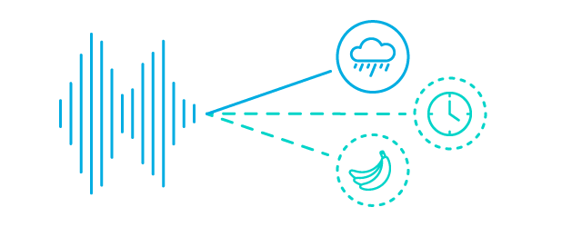
Overall Concept: NLU (Natural Language Understanding)
Sound
Meaning
Challenges
Inference of how to speak
Message meaning
Understanding Flexibility
Human patterns
Computer understanding
Context control
Error handling
ASR (automatic speech recognition)
Context
NLU (natural language understanding)
AI (Artificial Intelligence)

Slide 4
Overall Concept: Voice Interface
Invocation
Name
Intents
Spoken input A
Service A
Cloud-based Service
Spoken input B
Service B
Spoken input …
Service …
Sample utterances
slots
=
Example:
Intents
Services
Do_A
Can you call A
Please, A
A
Call A
MyApp
Do_A
Function_Do_A
Do_B
Do_C
Do_B
Do_C
Function_Do_B
Function_Do_C
Built-n intents
Cancel
Help
Stop
NavigateHome
https://developer.amazon.com/docs/custom-skills/create-the-interaction-model-for-your-skill.html

Slide 5
Creating a Skill
At the following link (https://developer.amazon.com/alexa/console/ask/build/), do the following:
Define an application audio invocation name
Define your application intents for this application
Give sample utterances for each intent name

Slide 6
Overall Concept: ASK (Alexa Skills Kit)

Slide 7




4 Tips to User Voice Experience Design
User intent: Drive users to be specific
User utterance: Give examples or be prepared to accept different words or phrases
User corrections: Give users the opportunity to correct or change
Treat exceptions: In case of doubt, don’t respond, ask more to be sure

Slide 8
Voice interactions Tips
Do not required user to learn how to use you application. It must be intuitive
Prevent information-heavy content
The best response is always what a human would say
Allow user to provide more information, do not ask at each step
Be simple

